Slide 1
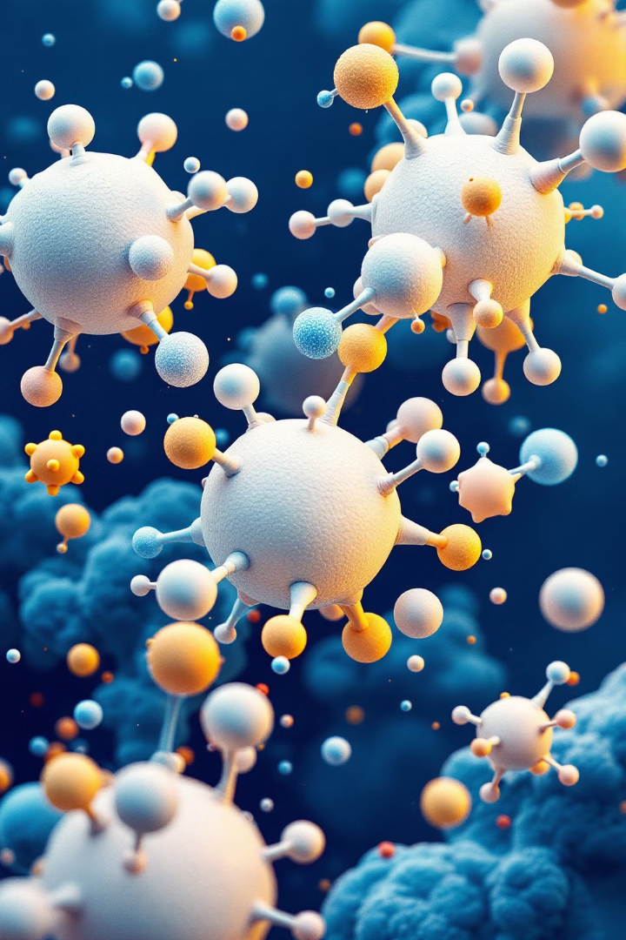
Molecular Dynamics Simulations: From Setup to Analysis
Molecular Dynamics (MD) simulations offer powerful insights into molecular behavior. This presentation explores the complete workflow, from system setup to advanced analysis techniques.
by Israa M. Shamkh

Slide 2
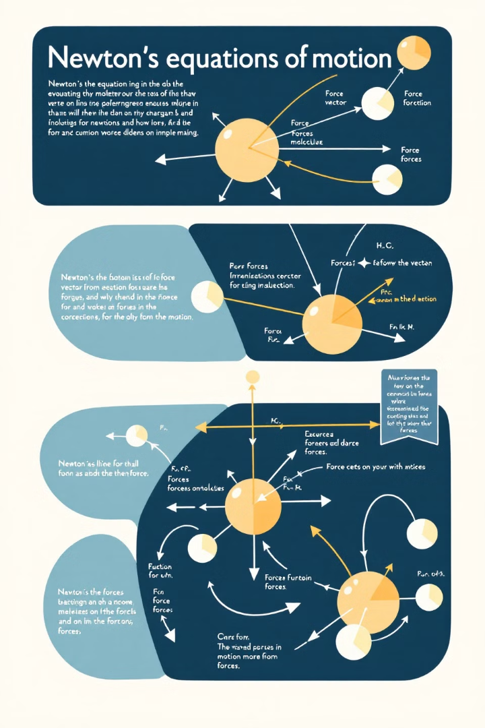
Fundamentals of Molecular Dynamics
1
Newton's Equations
MD simulations solve Newton's equations of motion for each atom in the system.
2
Time Evolution
The simulation progresses in discrete time steps, typically femtoseconds in duration.
3
Force Fields
Interactions between atoms are described by empirical potential energy functions called force fields.

Slide 3
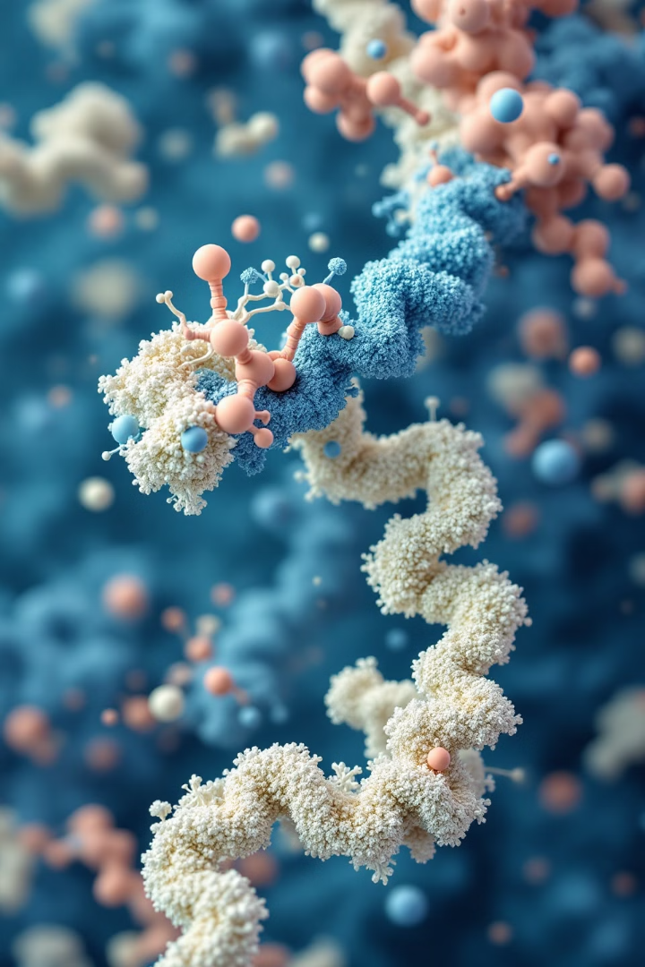
Applications in Biology and
Materials Science
Protein Folding
Drug-Receptor Interactions
MD simulations reveal the complex process of protein folding, crucial for understanding diseases.
These simulations aid in drug design by modeling how molecules interact with cellular receptors.
Material Properties
MD helps predict and understand material behavior at the atomic and molecular scale.

Slide 4
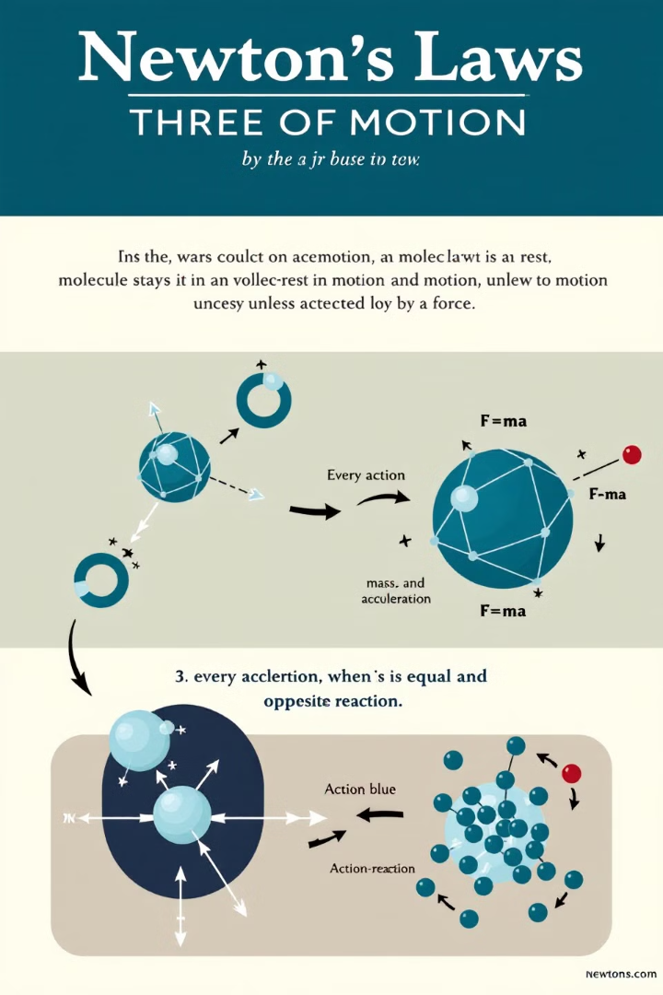
Fundamentals of Molecular Dynamics
1
Definition
2
Key Equation
MD simulates molecular behavior over time using Newton's equations of motion.
F = ma , is force, m is mass, and a is where Facceleration.
3
Application
MD reveals molecular interactions, dynamics, and properties in various systems.

Slide 5
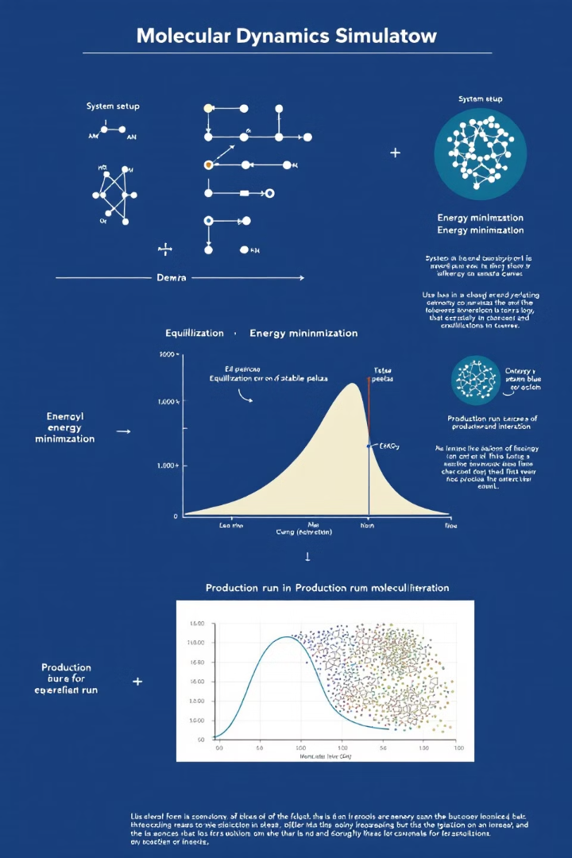
MD Simulation Workflow
1
System Setup
Obtain molecular structure, add solvent molecules, and ionize the system. Prepare the simulation environment.
2
Energy Minimization
Remove unfavorable atomic interactions using algorithms like Steepest Descent or Conjugate Gradient. Optimize initial structure.
3
Equilibration
Adjust temperature and pressure using NVT/NPT ensembles. Stabilize the system before production run.
4
Production Run
Execute main MD simulation. Collect trajectory data including atomic positions and velocities.

Slide 6
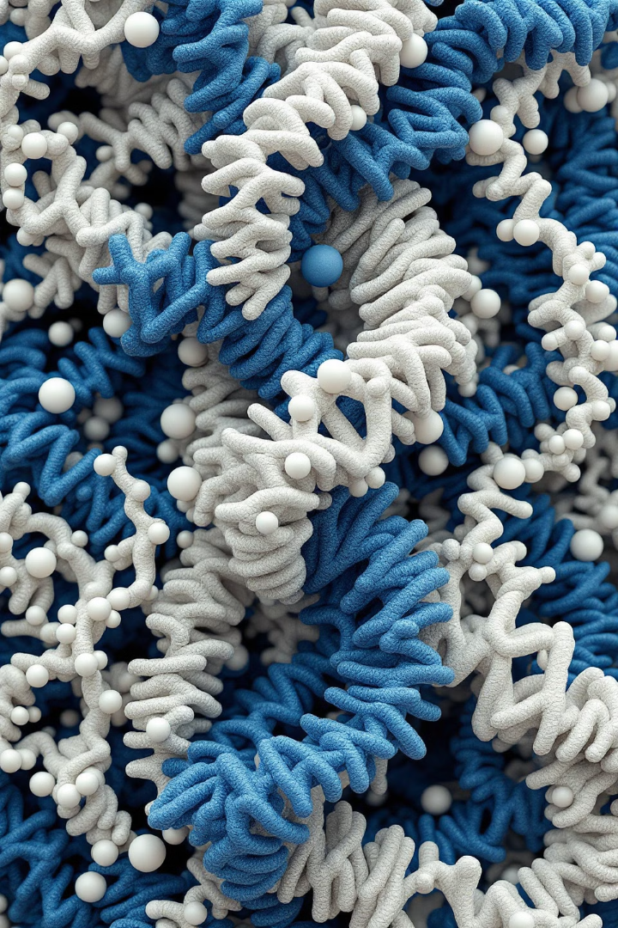
System Setup: Initial Structure
1
Obtain Structure
Source molecular structures from Protein Data Bank or similar databases.
2
Solvation
Add solvent molecules to create a realistic physiological environment.
3
Ionization
Introduce counter-ions to neutralize the system and adjust ionic strength.

Slide 7
Energy Minimization
Purpose
Process
Outcome
Minimize potential energy to eliminate unfavorable atomic interactions and steric clashes.
Use gradient-based algorithms like steepest descent or conjugate gradient.
Achieve a stable starting point for subsequent simulation stages.

Slide 8
Equilibration Phase
Initial Adjustment
Gradually adjust temperature and pressure using thermostats and barostats.
Stabilization
Allow system to reach desired temperature and pressure conditions.
Verification
Ensure system stability before proceeding to production run.

Slide 9
Ensemble Techniques: NVT and NPT
NVT Ensemble
NPT Ensemble
Importance
Constant number of particles, volume, and temperature. Useful for studying system behavior at specific volumes.
Constant number of particles, pressure, and temperature. Mimics typical laboratory conditions more closely.
These ensembles allow simulations to match experimental conditions and provide meaningful thermodynamic data.

Slide 10
Production Run
Purpose
Process
Collect data over extended periods under constant conditions.
Generate trajectory data tracking atomic positions, velocities, and properties.
Output
Duration
Provide insights into system dynamics and molecular interactions.
Typically runs for nanoseconds to microseconds of simulated time.

Slide 11
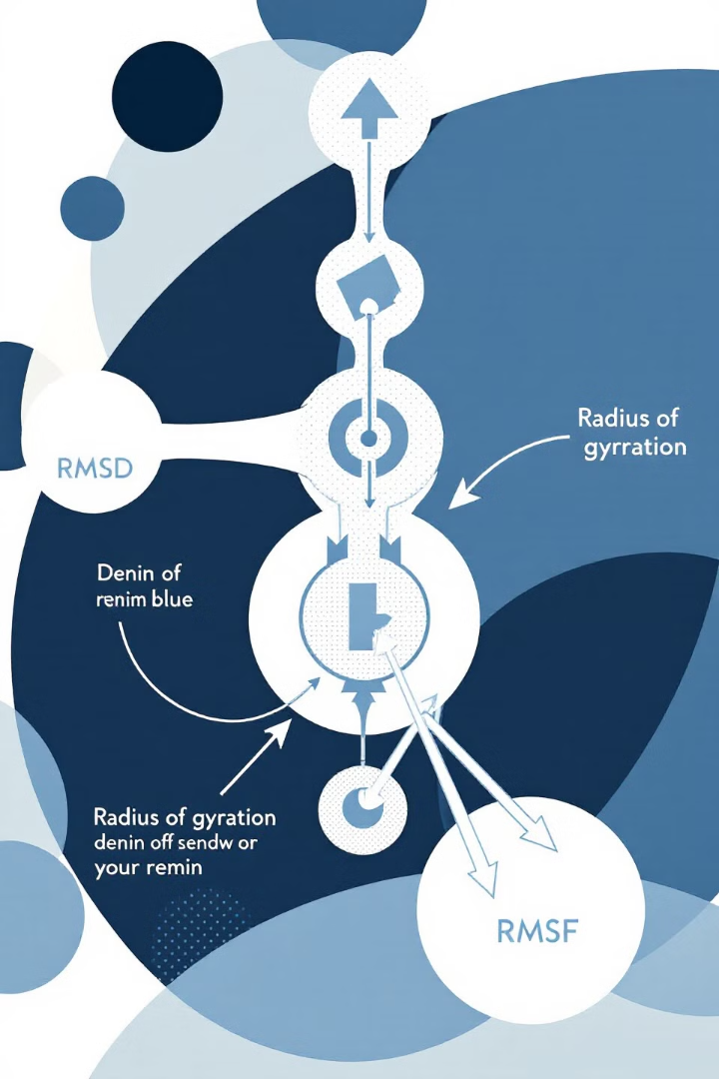
Structural Analysis Techniques
RMSD
RMSF
Radius of Gyration
Root Mean Square Deviation tracks overall structural stability. It measures the average distance between atoms.
Root Mean Square Fluctuation analyzes atomic flexibility. It identifies regions with high mobility.
Monitors system compactness. It calculates the distribution of atoms around the center of mass.

Slide 12
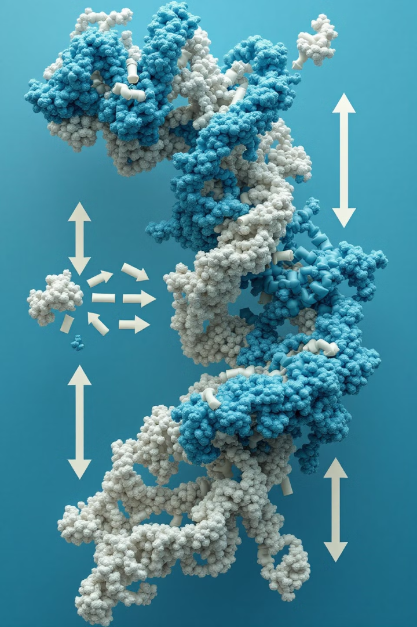
Advanced Analysis Techniques
Principal Component Analysis (PCA)
MM-PBSA
Calculates binding free energies. It evaluates van der Waals, electrostatic, and solvation energy contributions.
Identifies major conformational changes and essential motions in the system. It reduces data complexity.
Free Energy Calculations
Cluster Analysis
Includes methods like Free Energy Perturbation (FEP) and Thermodynamic Integration (TI). Quantifies energy landscapes.
Groups similar conformations. It helps identify dominant structural states throughout the simulation.

Slide 13
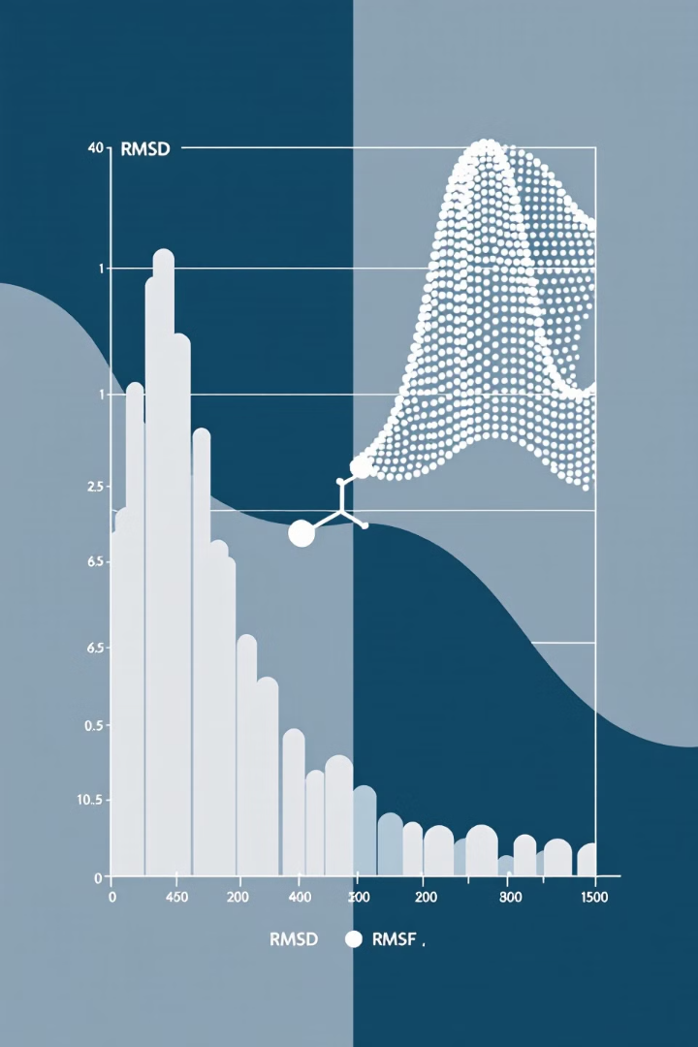
Structural Analysis: RMSD and RMSF
Metric
Purpose
Application
RMSD
Monitor overall structural stability
Compare to reference structure
RMSF
Measure atomic position fluctuations
Identify flexible/rigid regions

Slide 14
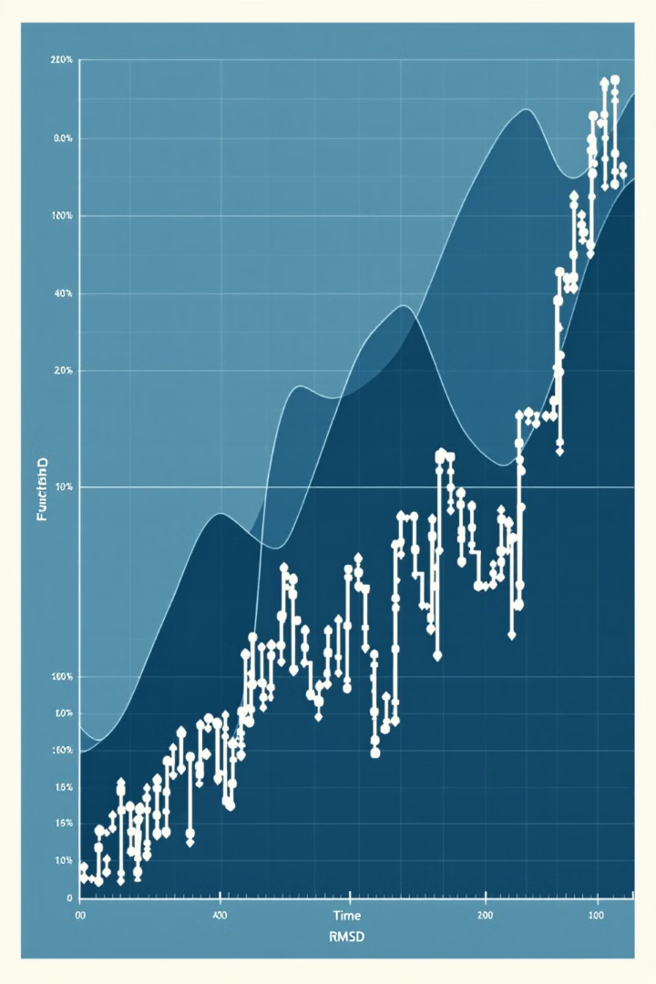
Radius of Gyration and
Hydrogen Bond Analysis
Radius of Gyration
Measures molecular compactness, indicating folding or unfolding events.
Hydrogen Bond Analysis
Tracks formation and dynamics of hydrogen bonds in the system.

Slide 15
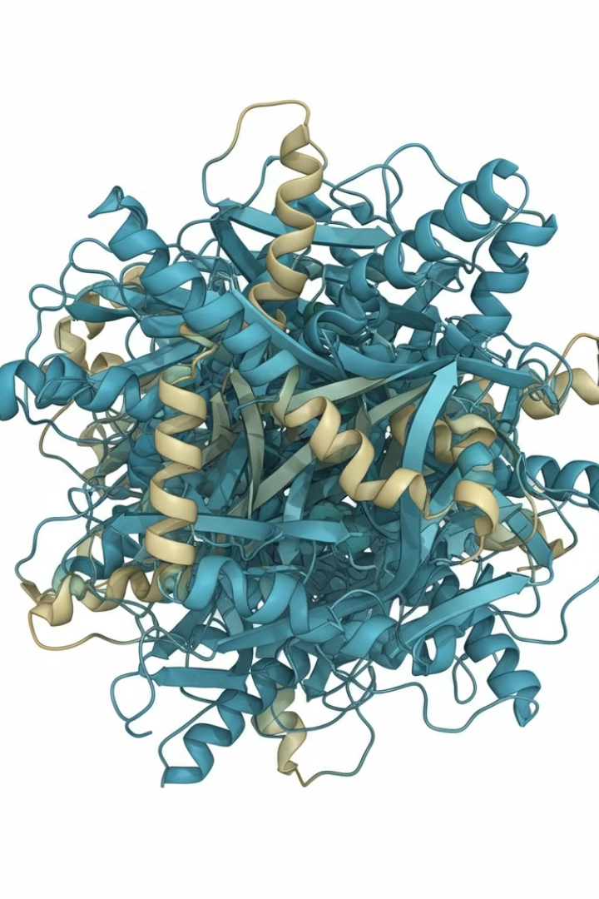
Secondary Structure Analysis
1
Initial State
Identify starting secondary structure elements in the molecule.
2
Dynamic Changes
Track formation and dissolution of alpha-helices and beta-sheets over time.
3
Final Analysis
Assess stability and changes in secondary structure throughout the simulation.

Slide 16
Principal Component Analysis (PCA)
1
Purpose
2
Method
Identify major modes of motion in the molecular system.
Reduce dimensionality of trajectory data to reveal essential dynamics.
3
Application
4
Tools
Study dominant conformational states and pathways in molecular movements.
Utilize GROMACS, AMBER, or NAMD for PCA calculations and visualization.

Slide 17
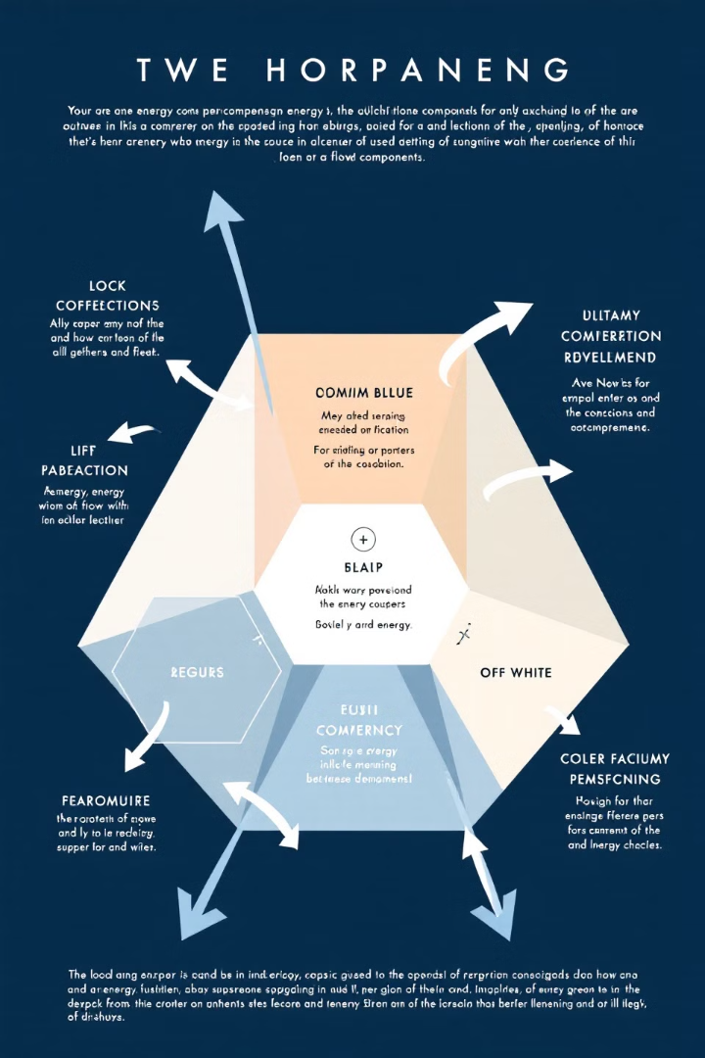
MM-PBSA: Binding Free Energy Calculations
Definition
Components
Molecular Mechanics Poisson-Boltzmann Surface Area method for binding energy estimation.
Combines molecular mechanics energies with solvation energies for comprehensive analysis.
Application
Tools
Estimate ligand-receptor binding affinities in drug discovery processes.
Utilize AMBER or GROMACS for MM-PBSA calculations and analysis.

Slide 18
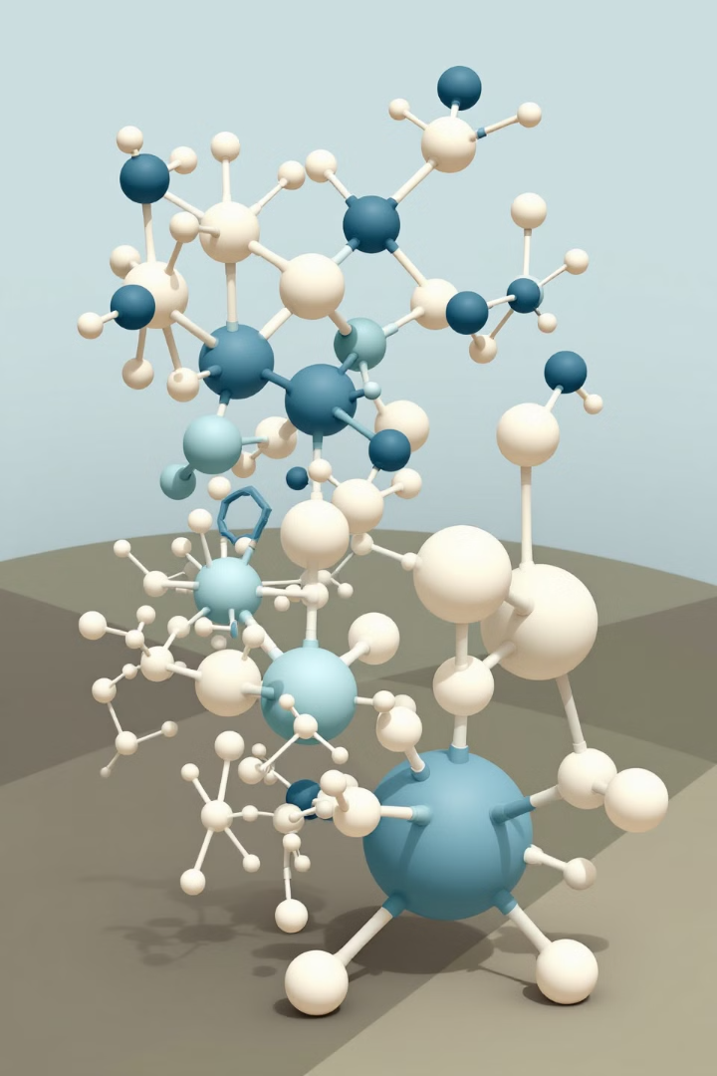
Advanced Free Energy Calculations
Free Energy Perturbation (FEP)
Thermodynamic Integration (TI)
Applications
Accurately predict binding affinities and conformational changes in molecular systems.
Computes free energy changes along a defined thermodynamic path.
Calculates free energy differences between similar states using alchemical transformations.

Slide 19
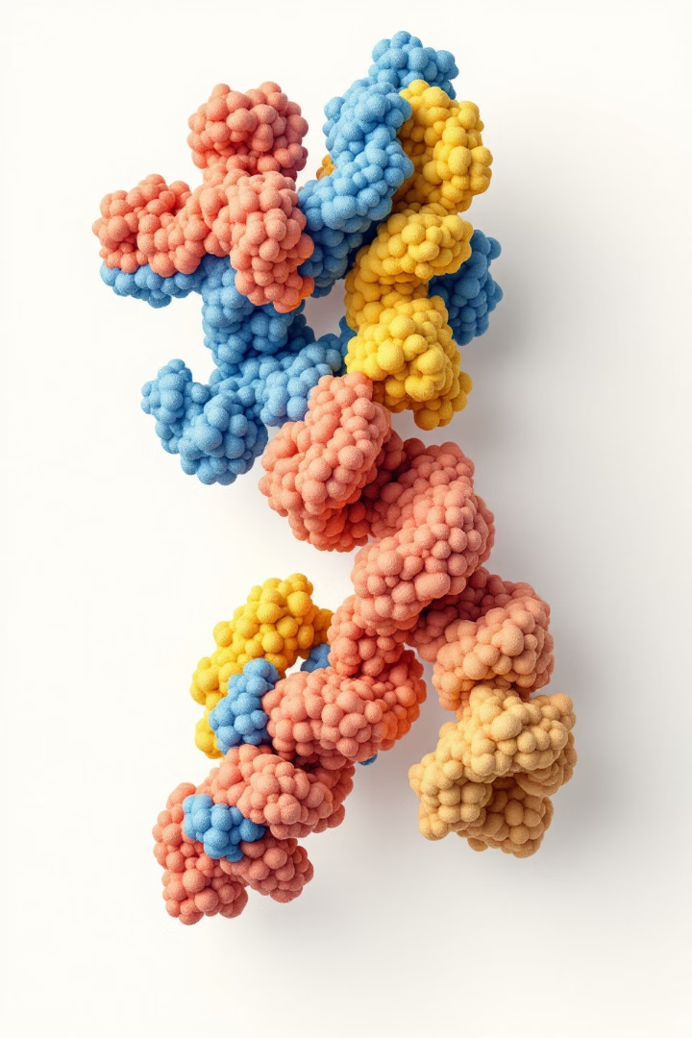
Solvent Accessibility and Surface Area Analysis
Calculate SASA
Quantify surface area accessible to solvent molecules.
Identify Binding Sites
Analyze hydrophobic patches and potential ligand binding regions.
Track Changes
Monitor SASA variations during protein folding or ligand binding.

Slide 20
Cluster Analysis and Contact Maps
Cluster Analysis
Contact Maps
Applications
Group similar structures to identify dominant conformational states.
Visualize interactions between atoms or residues within a molecule.
Identify key interaction sites and study conformational changes over time.

Slide 21
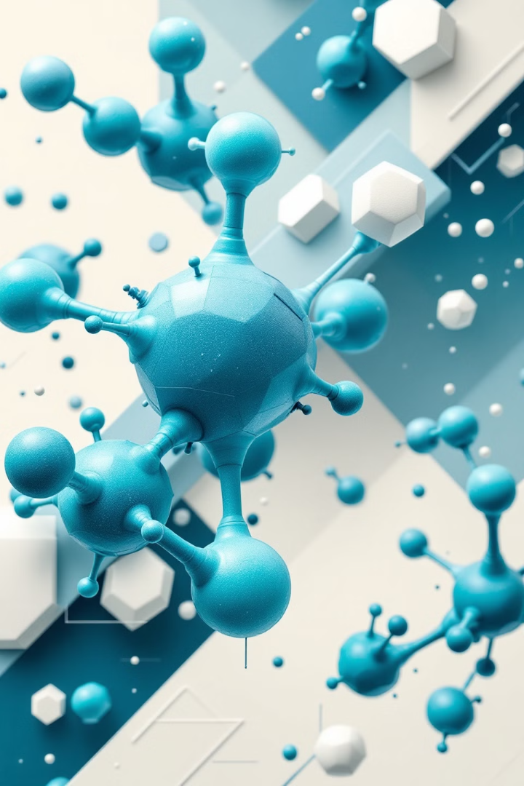
Future Directions in MD Simulations
AI Integration
Enhance simulation accuracy and speed using machine learning algorithms.
Extended Timescales
Develop methods for simulating biological processes on longer timescales.
Multi-scale Modeling
Combine atomistic and coarse-grained simulations for complex systems.

