Slide 1
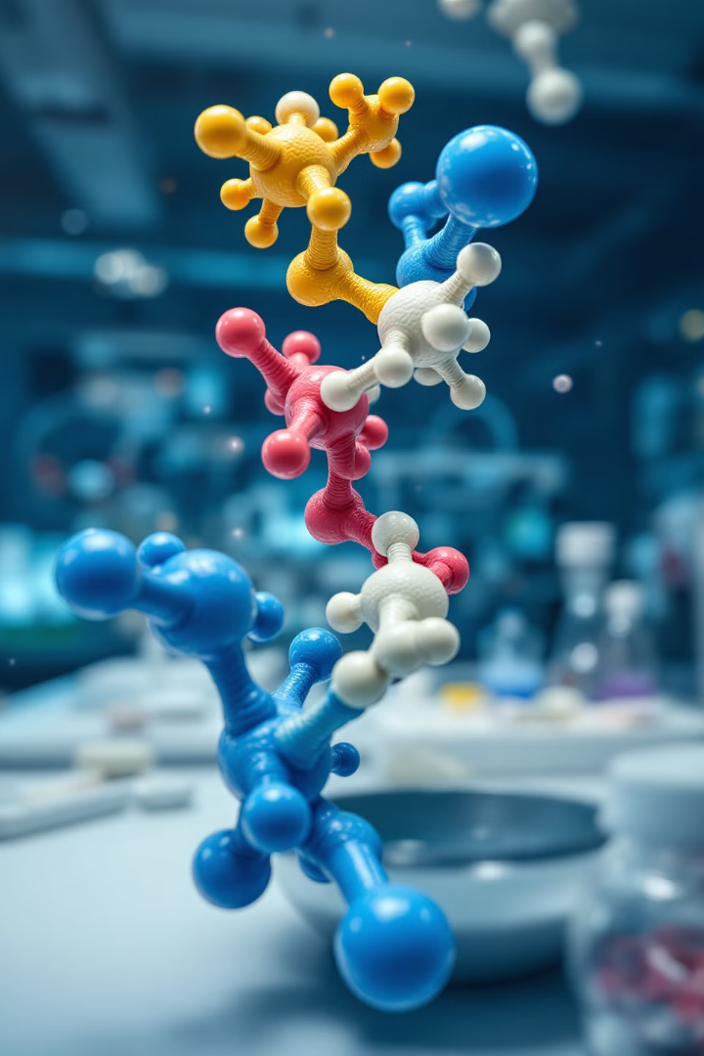
Molecular Docking and Virtual Screening: Computational Drug Discovery
Explore the cutting-edge techniques of molecular docking and virtual screening in drug discovery. These computational methods revolutionize the process of identifying potential drug candidates, saving time and resources in pharmaceutical research.
by Israa M. Shamkh

Slide 2
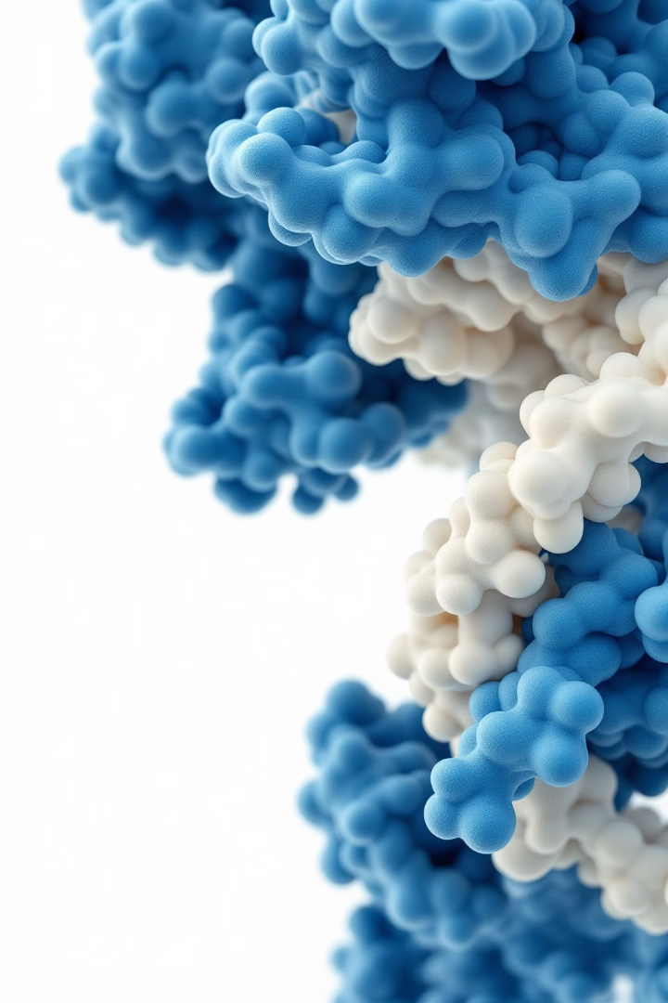
Principles of Molecular Docking
1
Concept Understanding
Molecular docking simulates ligand-receptor interactions. It predicts binding affinities and orientations of small molecules within target proteins.
2
Energy Calculations
Docking algorithms evaluate various poses. They calculate binding energies using force fields and scoring functions.
3
Pose Prediction
The lowest energy conformation is typically selected. This represents the most likely binding mode of the ligand.

Slide 3
Applications of Molecular Docking
Lead Discovery
Lead Optimization
Docking screens large compound libraries. It identifies potential drug candidates for further investigation.
Refines existing lead compounds. Guides chemical modifications to improve binding affinity and drug-like properties.
Mechanism Elucidation
Toxicity Prediction
Reveals molecular interactions between drugs and targets. Helps understand the mechanism of action of pharmaceutical compounds.
Assesses potential off-target interactions. Identifies possible side effects early in the drug development process.

Slide 4
Featured Molecular Docking Tools
AutoDock Vina
Schrödinger Glide
MOE
Open-source docking software. Known for its speed and accuracy in predicting binding modes.
Commercial software with advanced algorithms. Offers high-throughput virtual screening capabilities for drug discovery.
Comprehensive suite for molecular modeling. Provides tools for docking, structure-based design, and pharmacophore modeling.

Slide 5
Virtual Screening Process
Library Preparation
Docking Simulation
Hit Identification
Curate diverse compound libraries. Ensure proper 3D conformations and physicochemical properties of molecules.
Perform high-throughput docking. Screen thousands to millions of compounds against the target protein.
Analyze docking results and scores. Select top-ranking compounds as potential drug candidates for experimental validation.

Slide 6
Types of Virtual Screening
Structure-Based Screening
Ligand-Based Screening
Utilizes 3D structure of the target receptor. Docks compounds into the binding site to predict interactions.
Uses known active compounds as templates. Searches for molecules with similar properties or structural features.
Requires high-resolution protein structures
Employs pharmacophore modeling and QSAR
Considers protein flexibility and water molecules
Effective when target structure is unavailable
Suitable for novel targets with unknown ligands
Relies on the quality of known active compounds

Slide 7
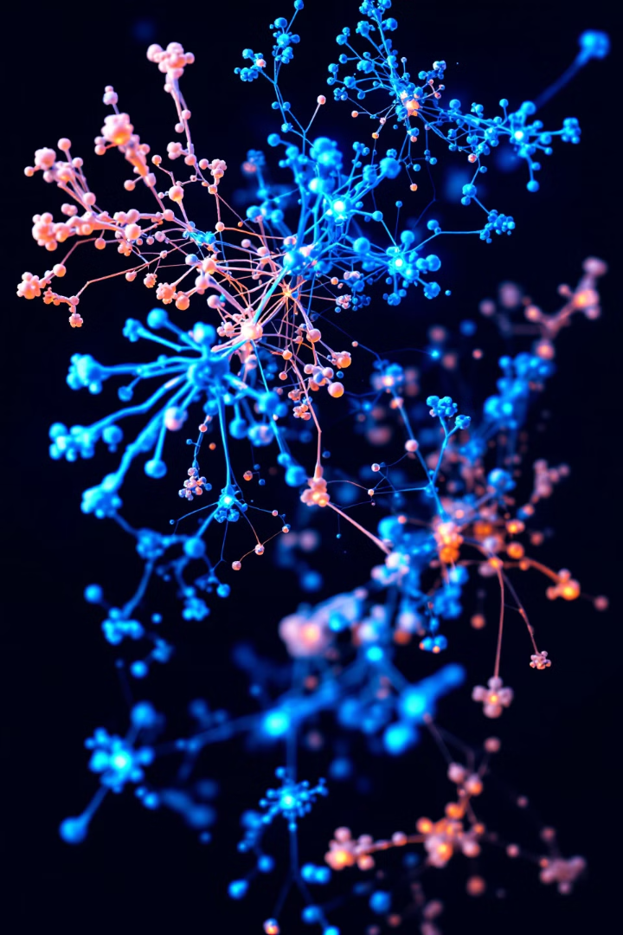
Bioinformatics and Protein-Protein Interactions: A Deep Dive
This course explores the intricate world of protein sequence analysis and protein-protein interaction networks. We'll delve into essential concepts, tools, and applications in bioinformatics.
by Israa M. Shamkh

Slide 8
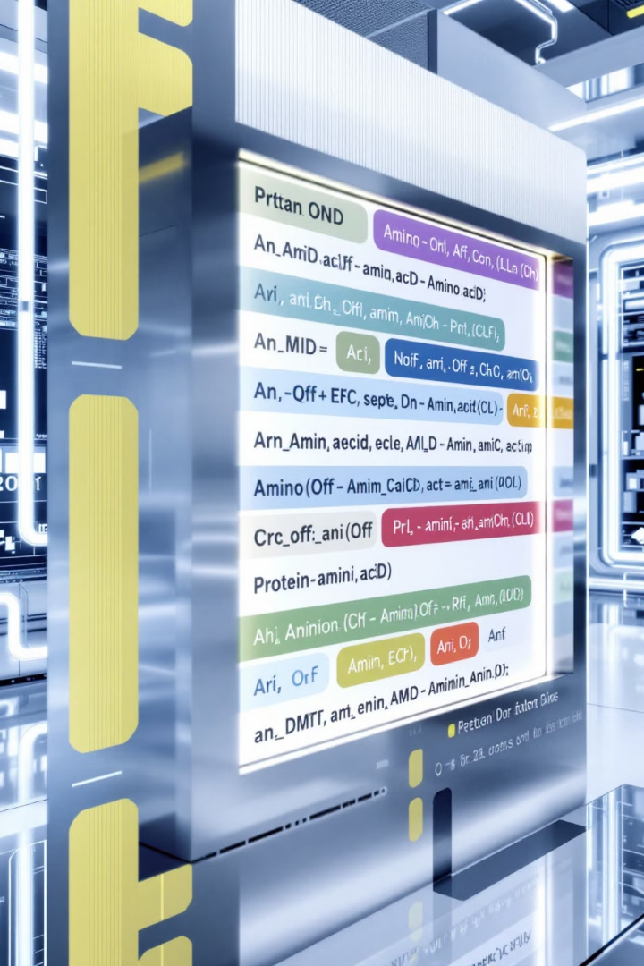
Protein Sequence Analysis: Fundamentals
1
Sequence Alignment
Comparing protein sequences to identify similarities. Critical for understanding evolutionary relationships and functional domains.
2
Conserved Motifs
Identifying shared sequence patterns across proteins. These motifs often indicate functional or structural importance.
3
Phylogenetic Relationships
Constructing evolutionary trees based on sequence similarities. Reveals protein family relationships and functional divergence.

Slide 9
Tools for Protein Sequence Analysis
MEGA
Molecular Evolutionary Genetics Analysis software. Performs sequence alignments, infers phylogenetic trees, and estimates evolutionary rates.
Clustal Omega
Multiple sequence alignment program. Uses seeded guide trees and HMM profile-profile techniques.
Jalview
Java-based multiple sequence alignment editor. Allows visualization, analysis, and manipulation of alignments.

Slide 10
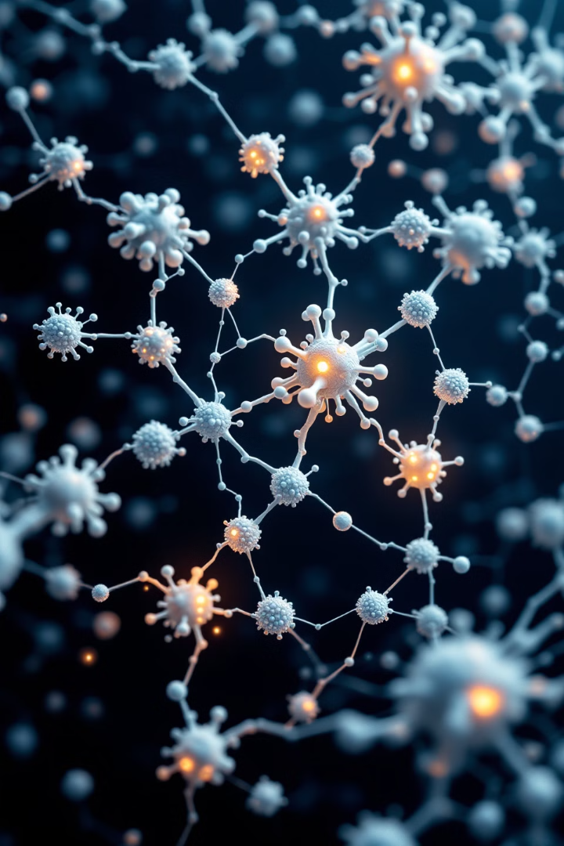
Protein-Protein Interaction Networks: An Overview
1
Network Complexity
2
Dynamic Nature
PPI networks represent intricate relationships between proteins in cellular systems. They reveal functional dependencies and biological pathways.
Interactions can be transient or stable. Network dynamics reflect cellular responses to stimuli.
3
Biological Significance
Understanding PPIs is crucial for deciphering cellular functions. They influence cellular processes, signaling pathways, and disease mechanisms.

Slide 11
Applications of PPI Networks in Disease Treatment
Target Identification
Drug Repurposing
Personalized Medicine
PPI networks help identify key proteins in disease pathways. These become potential targets for drug development.
Analyzing PPI networks can reveal new applications for existing drugs. This accelerates the drug discovery process.
PPI analysis aids in understanding individual disease profiles. This enables tailored treatment strategies for patients.

Slide 12
STRING: Protein-Protein Interaction Database
Comprehensive Database
Interaction Sources
STRING integrates known and predicted protein-protein interactions. It covers a wide range of organisms.
Includes experimental data, computational prediction methods, and public text collections. Provides a comprehensive view of protein interactions.
Visualization Tools
Integration Capabilities
Offers interactive network visualizations. Allows exploration of protein interactions and functional associations.
Can be integrated with other bioinformatics tools. Enhances the analysis of protein functions and interactions.

Slide 13
Cytoscape: Network Analysis and Visualization
Data Import
Cytoscape can import various data formats. It integrates interaction data from multiple sources.
Network Manipulation
Users can modify network layouts and attributes. This allows for customized visualization of complex interactions.
Analysis Tools
Cytoscape offers various network analysis plugins. These enable advanced topological and functional analyses of PPI networks.
Result Export
Analyzed networks can be exported in various formats. This facilitates further analysis or publication-ready figures.

Slide 14
InterPro: Protein Sequence Analysis & Classification
Feature
Description
Application in PPI Studies
Protein Signatures
Identifies functional domains and motifs
Predicts potential interaction sites
Integrated Databases
Combines multiple protein signature databases
Comprehensive protein function analysis
GO Annotations
Provides Gene Ontology terms
Functional context for protein interactions

Slide 15
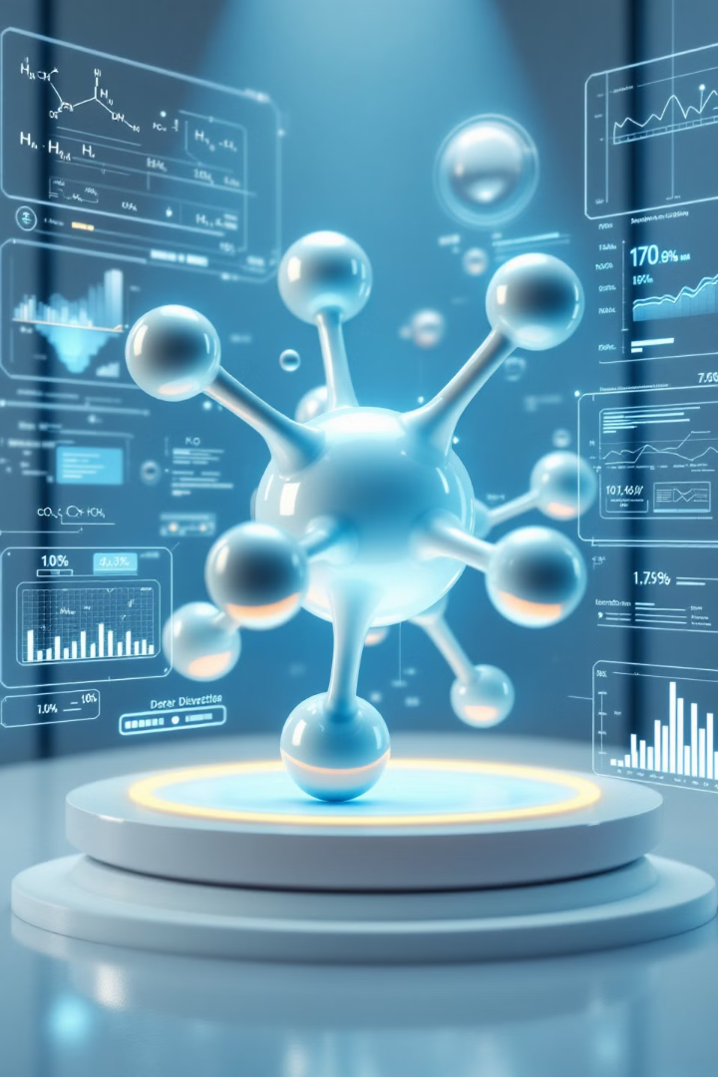
Advanced Computational Techniques in Drug Discovery
Exploring QSAR modeling and ADMET profiling for efficient drug development.
by Israa M. Shamkh

Slide 16
QSAR Modeling: Definition and Purpose
1
Quantitative Structure-Activity Relationship
2
Predictive Power
Forecasts compound efficacy and toxicity.
Correlates molecular structures with biological activities.
3
Streamlining Drug Discovery
Reduces time and resources in lead optimization.

Slide 17
QSAR Modeling: Key Components
Molecular Descriptors
Statistical Analysis
Validation Methods
Numerical values representing structural properties.
Regression techniques to establish structure-activity relationships.
Cross-validation and external test sets.

Slide 18
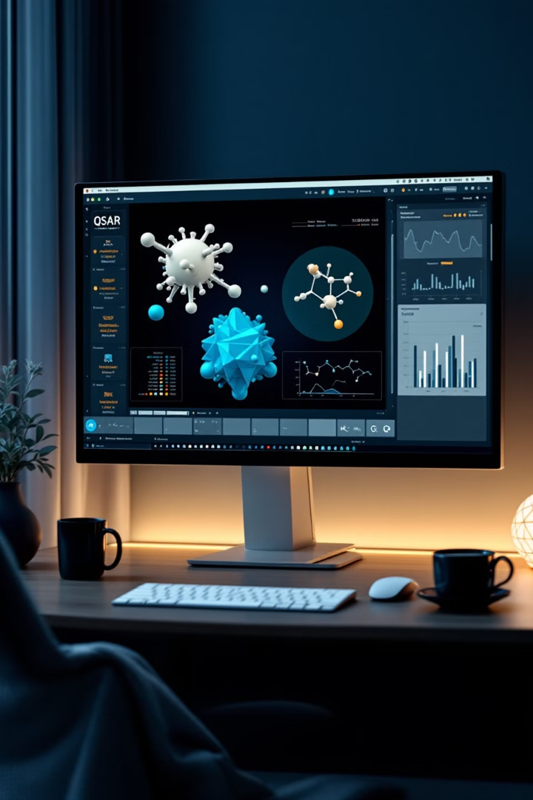
QSAR Modeling Tools
Maestro
Comprehensive modeling and simulation platform.
MOE
Molecular Operating Environment for drug discovery.
Discovery Studio
Integrated modeling and simulations for life sciences.

Slide 19
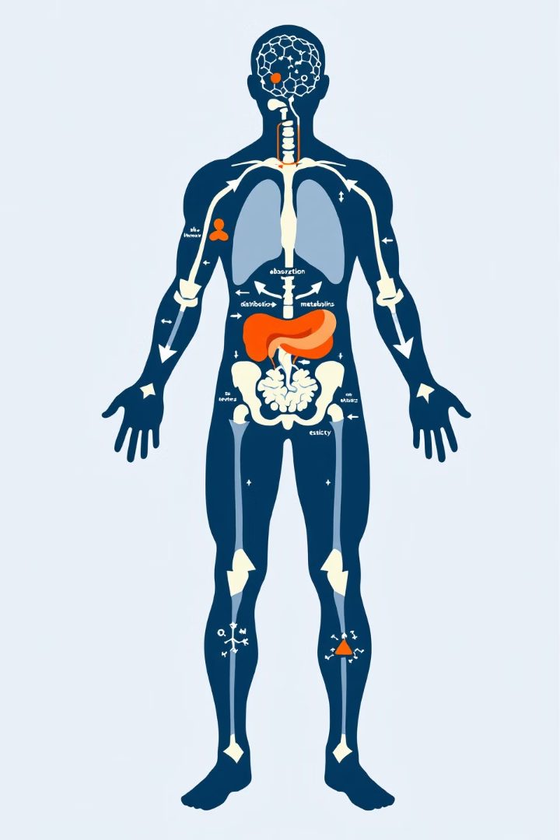
ADMET Profiling: Overview
Absorption
Distribution
Compound's ability to enter bloodstream.
Spread of compound throughout body.
Metabolism
Excretion
Biotransformation of compound in body.
Elimination of compound from body.

Slide 20
ADMET Profiling: Importance in Drug Discovery
1
Early Screening
Identifies potential issues before clinical trials.
2
Cost Reduction
Minimizes late-stage failures in drug development.
3
Safety Assessment
Predicts toxicity and adverse effects.
4
Optimized Formulation
Guides drug delivery system design.

Slide 21
ADMET Profiling Tools
Tool
Primary Function
Key Feature
SwissADME
Physicochemical descriptors
Web-based, user-friendly interface
DEREK Nexus
Toxicity prediction
Knowledge-based expert system
ProTox-II
Oral toxicity prediction
Machine learning-based approach

Slide 22
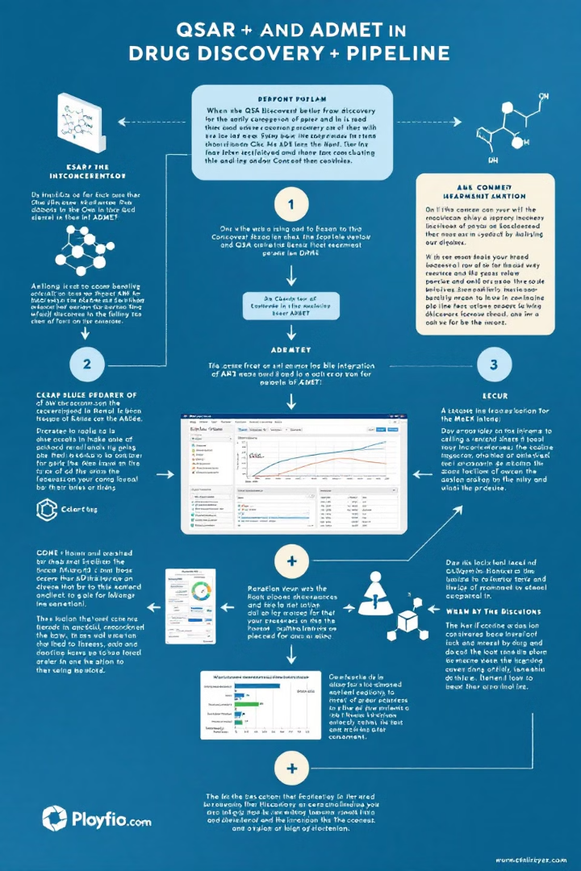
Integration of QSAR and ADMET in Drug Discovery
Lead Identification
QSAR models predict active compounds.
Lead Optimization
ADMET profiling guides structural modifications.
Candidate Selection
Combined approach selects promising drug candidates.

