Slide 1
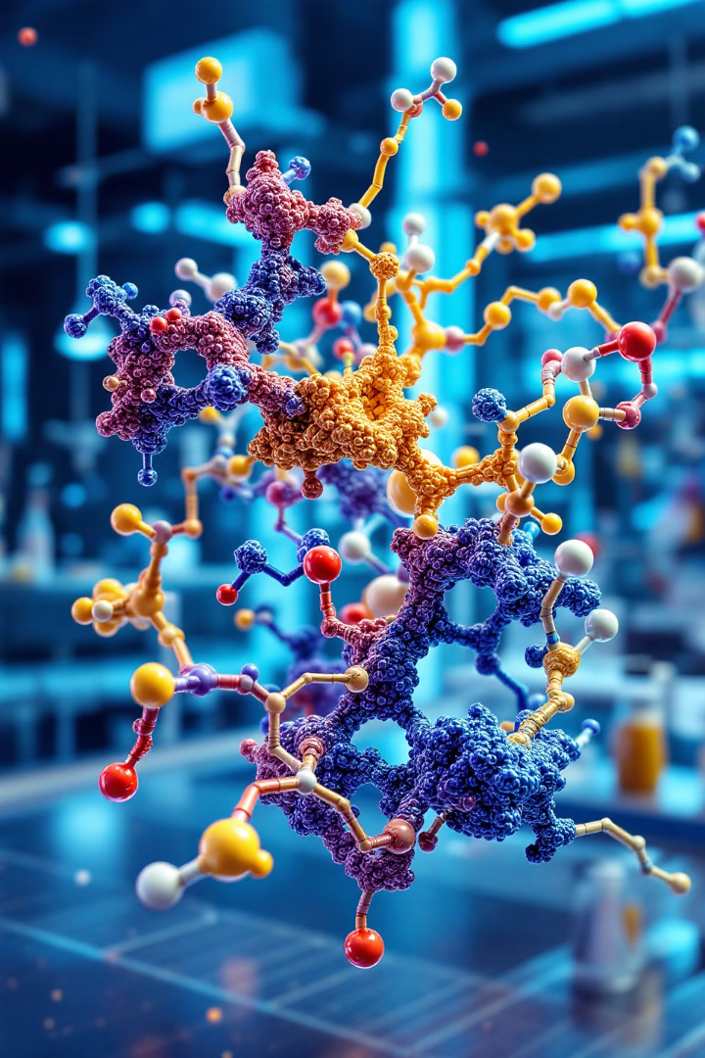
Fundamentals of Computer-Aided Drug Design (CADD)
Computer-Aided Drug Design revolutionizes pharmaceutical research. It combines computational methods with chemical and biological data. CADD accelerates drug discovery and development processes. It reduces costs and improves efficiency in creating new therapeutic compounds.

Slide 2
Structure-Based Drug Design (SBDD)
3D Protein Structures
Virtual Screening
Binding Site Analysis
SBDD utilizes high-resolution 3D structures of target proteins. These structures are obtained through X-ray crystallography or NMR spectroscopy.
Large compound libraries are computationally screened against the target protein. This process identifies potential drug candidates efficiently.
Detailed analysis of protein binding sites guides drug design. It helps in optimizing ligand-protein interactions for improved efficacy.

Slide 3
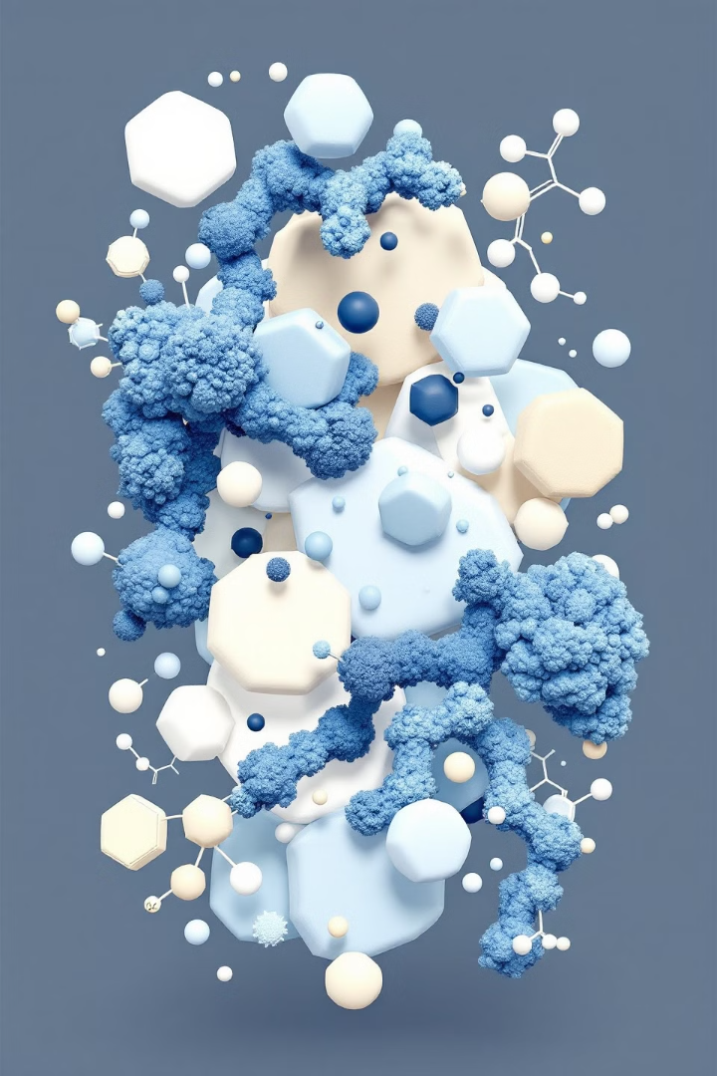
Ligand-Based Drug Design (LBDD)
1
Identify Active Compounds
Known active compounds serve as starting points. These are typically drugs or natural ligands that bind to the target.
2
Analyze Chemical Features
Key chemical features of active compounds are identified. These include functional groups, shape, and electrostatic properties.
3
Design New Analogs
New drug candidates are designed based on the analyzed features. This process often involves modifying existing compounds.

Slide 4
Core Applications of CADD
Lead Identification
Lead Optimization
ADMET Prediction
CADD techniques screen large compound libraries. They identify promising lead compounds for further development. This process significantly accelerates early-stage drug discovery.
Computational methods refine lead compounds. They improve potency, selectivity, and drug-like properties. This stage often involves iterative design and testing cycles.
CADD tools predict crucial pharmacokinetic properties. These include absorption, distribution, metabolism, excretion, and toxicity. Early ADMET predictions help prioritize compounds and reduce late-stage failures.

Slide 5
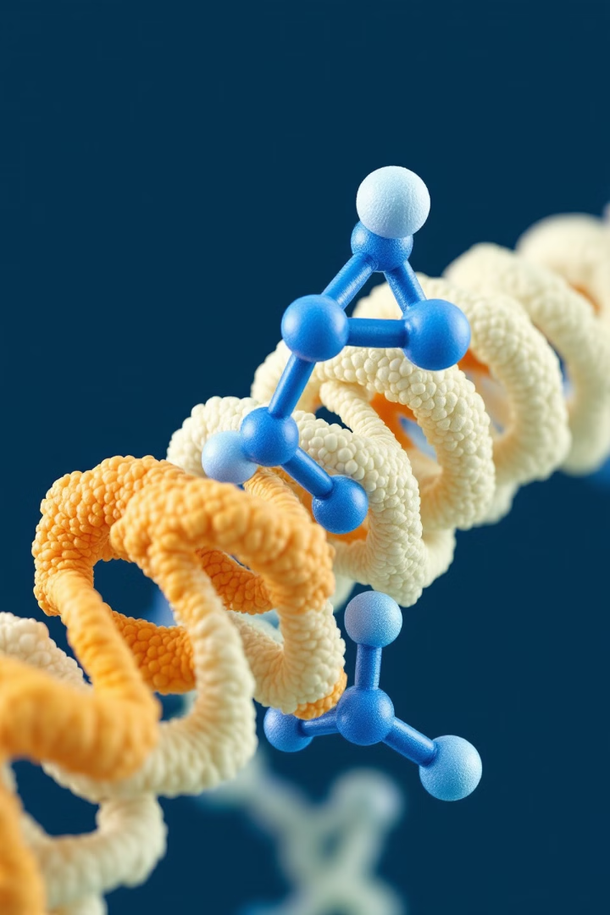
Molecular Docking
Prepare Structures
Protein and ligand structures are prepared for docking. This involves adding hydrogen atoms and assigning charges.
Generate Conformations
Multiple ligand conformations are generated. This explores possible binding poses in the protein's active site.
Score Interactions
Docking algorithms score protein-ligand interactions. The best-scoring poses predict the most likely binding modes.
Analyze Results
Docking results are analyzed for binding affinity and interactions. This guides further optimization of lead compounds.

Slide 6
QSAR and Pharmacophore Modeling
QSAR Modeling
Pharmacophore Design
Virtual Screening
QSAR correlates chemical structures with biological activity. It uses statistical methods to predict properties of new compounds.
Pharmacophores represent essential features for biological activity. They guide the design of new active compounds.
QSAR and pharmacophore models screen large compound databases. They identify potential new drug candidates efficiently.

Slide 7
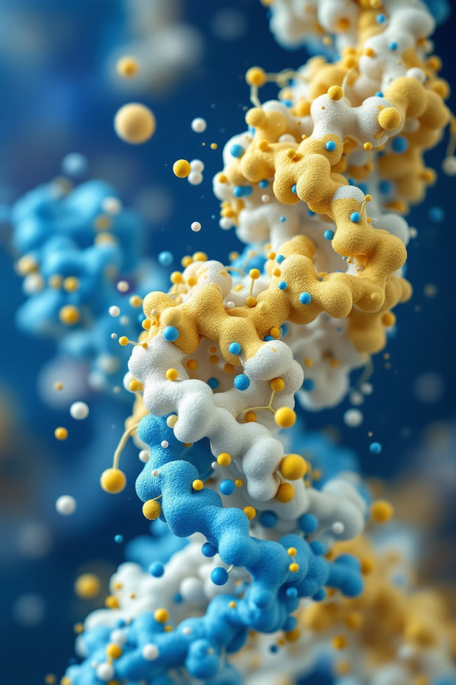
Molecular Dynamics Simulations
1
Setup
Define system, force field, and simulation parameters.
2
Equilibration
Stabilize system under desired conditions.
3
Production
Generate trajectory for analysis of protein dynamics.
4
Analysis
Extract insights from simulation data.

Slide 8
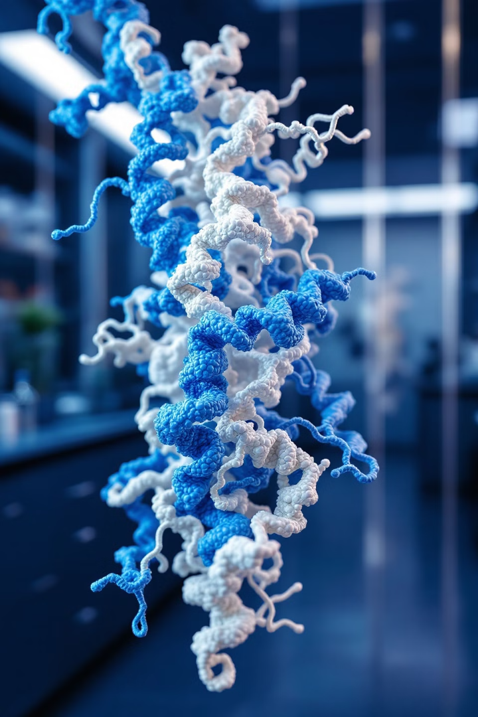
Protein Structure and Molecular Modeling
Explore protein structures and modeling techniques in biochemistry.
by Israa M. Shamkh

Slide 9
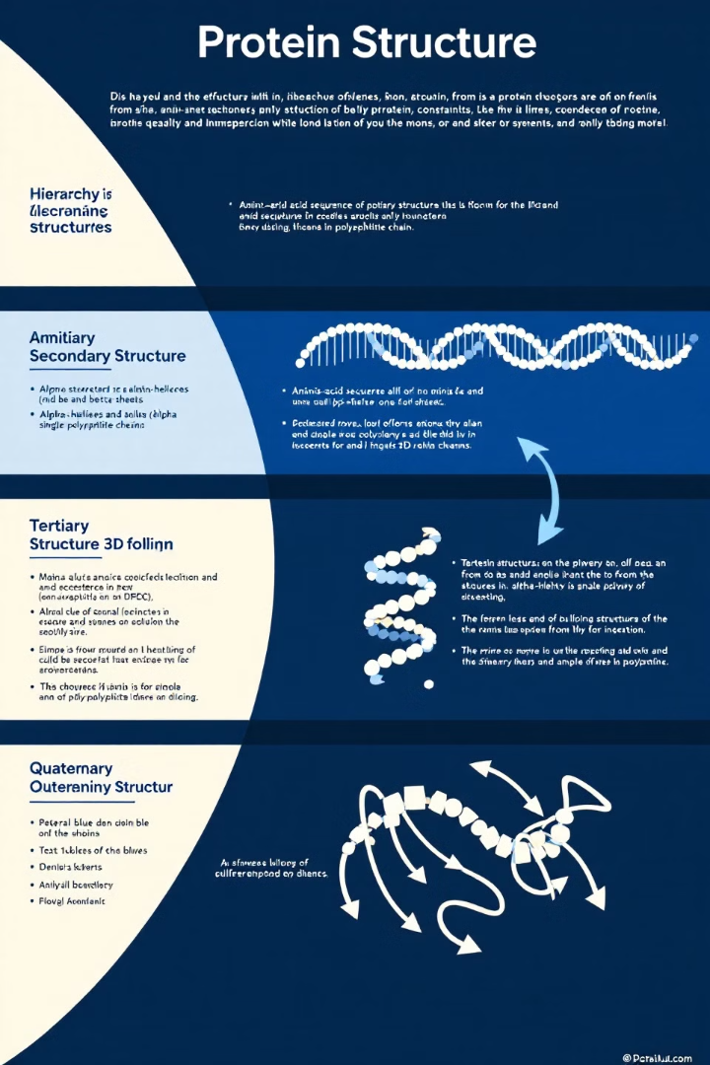
Protein Structure Hierarchy
1
Primary Structure
Amino acid sequence defines protein's foundation.
2
Secondary Structure
Alpha-helices and beta-sheets form local conformations.
3
Tertiary Structure
3D folding of single protein molecule.
4
Quaternary Structure
Multiple subunits assemble into functional complex.

Slide 10
Active Sites and Motifs
Active Sites
Allosteric Sites
Structural Motifs
Catalytic regions crucial for enzymatic activity.
Regulatory regions modulate protein function.
Recurring patterns in protein architecture.

Slide 11
Protein Modeling Tools
Swiss-Model
Web-based homology modeling suite.
Modeller
Python-based comparative protein structure modeling.
PyMOL
Molecular visualization system for 3D structures.

Slide 12
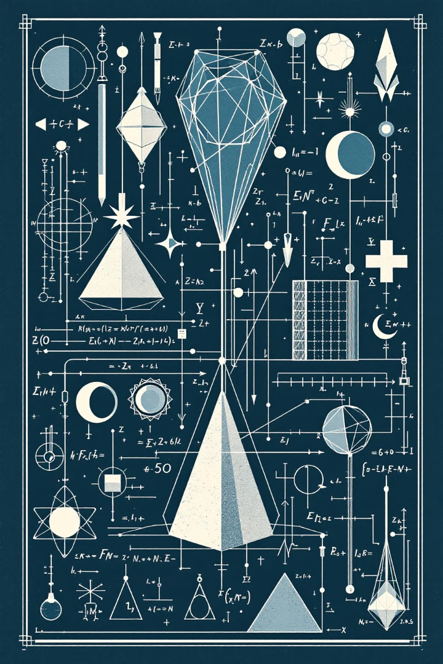
Force Fields in Molecular Modeling
1
Definition
2
Components
Mathematical representations of molecular interactions.
Bonded and non-bonded terms describe atomic forces.
3
Applications
Crucial for molecular dynamics simulations.

Slide 13
Common Force Fields
AMBER
CHARMM
Widely used for proteins and nucleic acids.
Versatile for biomolecules and small molecules.
OPLS-AA
GROMOS
Optimized for liquid simulations and proteins.
United-atom force field for efficient simulations.

Slide 14
Energy Minimization
Purpose
Process
Result
Stabilizes structures before docking or simulation.
Iteratively adjusts atomic positions to reduce energy.
Optimized structure closer to native conformation.

Slide 15
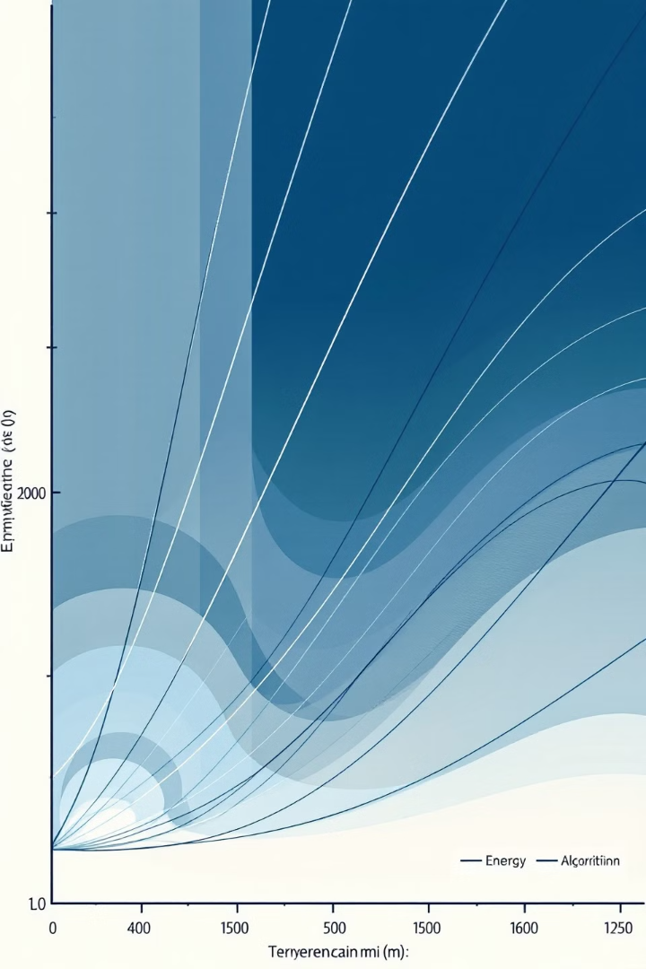
Energy Minimization Algorithms
Algorithm
Speed
Accuracy
Use Case
Steepest Descent
Fast
Lower
Initial minimization
Conjugate Gradient
Moderate
Higher
Refined minimization
Newton-Raphson
Slow
Highest
Final optimization

Slide 16
Molecular Dynamics Simulations
1
Setup
Define system, force field, and simulation parameters.
2
Equilibration
Stabilize system under desired conditions.
3
Production
Generate trajectory for analysis of protein dynamics.
4
Analysis
Extract insights from simulation data.

Slide 17
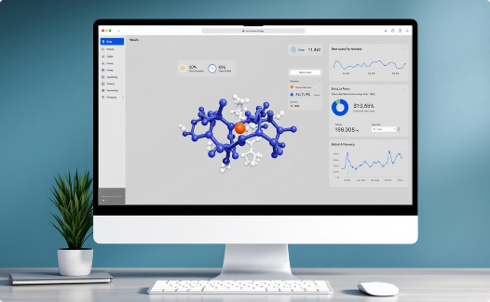
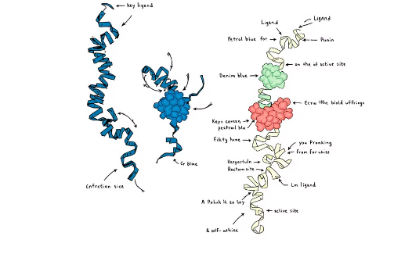
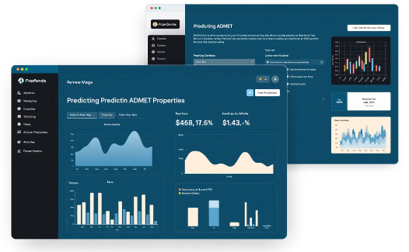
Applications in Drug Discovery
Virtual Screening
Binding Affinity Prediction
ADMET Prediction
Efficiently identify potential drug candidates.
Estimate drug-target interactions computationally.
Predict drug properties for lead optimization.

Slide 18
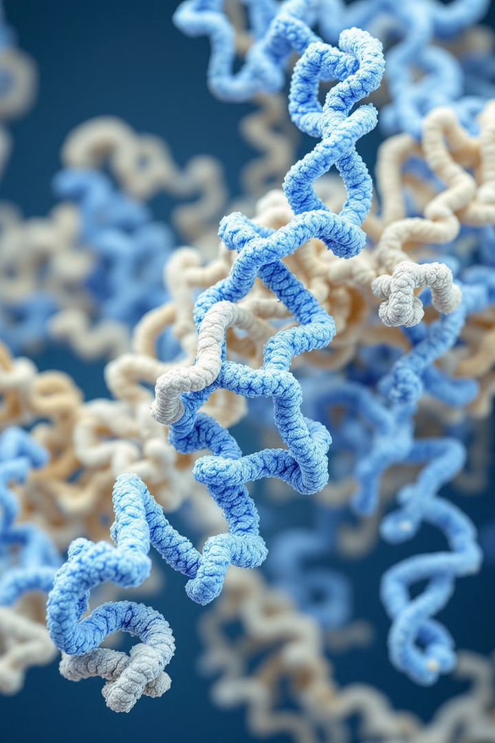
Thanks

